Slide 1



INSTITUTE - UIE
Bachelor of Engineering (Computer Science & Engineering) Subject Name : CALCULUS & VECTOR SPACES
Subject Code : 20SMT-175
BE :CSE(All IT branches)
DISCOVER . LEARN . EMPOWER
Introduction to Partial Differentiation

Slide 2
Course prerequisites
Basic Knowledge of Differentiation.
Basic Knowledge of Integration.
Basic Knowledge of Limits.
Basic Knowledge of binary operations.
Course Outcomes
CO Number | Title | Level
CO1 | The concept of partial derivatives and its application in real life situations The concept of Multiple Integrals and its applications. | Remember & Understand
CO2 | The concept of Group theory and its application of analysis to Engineering problems. | Remember & Understand
CO3 | The concept of vector spaces in a comprehensive manner. | Remember & Understand

Slide 3
Topic Pre-Requisites
Basic idea of limit and continuity.
Basic concepts of functions with one independent variables.
Basic knowledge of formulae of simple differentiation

Slide 4
Topic outcomes
To understand the basic concepts of Partial Differentiation.
To learn how to find the partial derivatives of functions having two or more independent variables.
To apply the concept of partial derivatives to solve mathematical problems

Slide 5
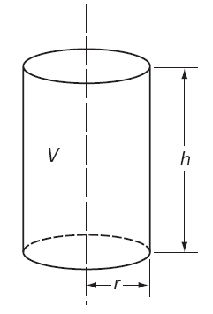
Partial differentiation
First order partial derivatives
The volume V of a cylinder of radius r and height h is given by:
If r is kept constant and h increases then V increases. We can find the rate of change of V with respect to h by differentiating with respect to h, keeping r constant:
This is called the first partial derivative of V with respect to h.

Slide 6
Partial differentiation
Similarly, if h is kept constant and r increases then again, V increases. We can then find the rate of change of V by differentiating with respect to r keeping h constant:
This is called the first partial derivative of V with respect to r.

Slide 7
First order Partial Derivatives
If z(x, y) is a function of two real variables it possesses two first partial derivatives.
One with respect to x,
obtained by keeping y fixed and
one with respect to y,
obtained by keeping x fixed.
All the usual rules for differentiating sums, differences, products, quotients and functions of a function apply.

Slide 8
Example
A partial derivative of a function of several variables is the ordinary derivative
w.r.t. one of the variables when all the remaining variables are held constant for
Let f( x ,y )=x²+y²
= 2x , here y is kept constant
= 2y , here x is kept constant

Slide 9
Higher Derivatives
The first partial derivatives of a function of two variables are each themselves likely to be functions of two variables and so can themselves be differentiated. This gives rise to four second-order partial derivatives:
If the two mixed second-order derivatives are continuous then they are equal

Slide 10
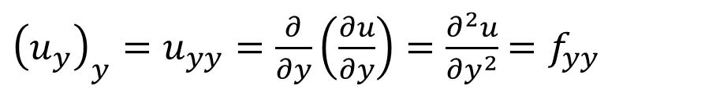
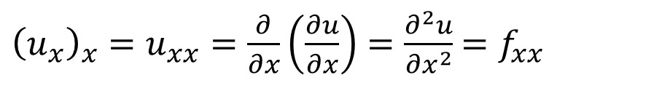
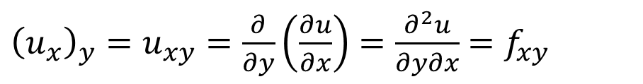
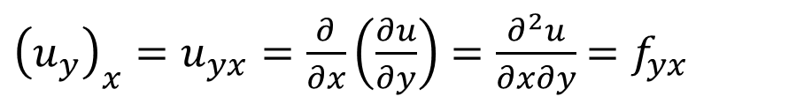
Higher Derivatives(Cont’d)
If u = f(x, y), we use the following notation also
$${\left(u_{x}\right)}_{x}=u_{xx}=\frac{∂}{∂x}\left(\frac{∂u}{∂x}\right)=\frac{∂^{2}u}{{∂x}^{2}}=f_{xx}$$
$${\left(u_{y}\right)}_{y}=u_{yy}=\frac{∂}{∂y}\left(\frac{∂u}{∂y}\right)=\frac{∂^{2}u}{{∂y}^{2}}=f_{yy}$$
$${\left(u_{y}\right)}_{x}=u_{yx}=\frac{∂}{∂x}\left(\frac{∂u}{∂y}\right)=\frac{∂^{2}u}{∂x∂y}=f_{yx}$$
$${\left(u_{x}\right)}_{y}=u_{xy}=\frac{∂}{∂y}\left(\frac{∂u}{∂x}\right)=\frac{∂^{2}u}{∂y∂x}=f_{xy}$$

Slide 11
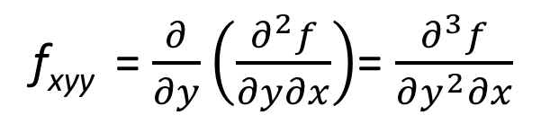
Higher Derivatives(Cont’d)
Partial derivatives of order 3 or higher can also be defined. For instance

Slide 12
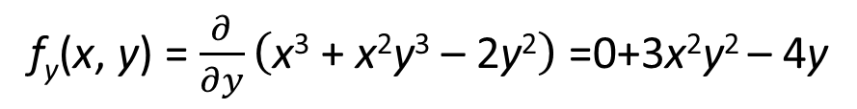
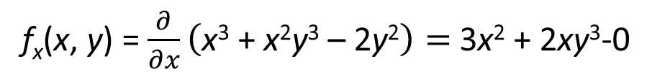
Example
Find the second partial derivatives of
f(x, y) = x³ + x²y³ – 2y²
Solution : first order partial derivatives are given by
f_{x}(x, y) = $\frac{∂}{∂x}\left(\text{x}\text{3}\text{ + }\text{x}\text{2}\text{y}\text{3}\text{ – 2}\text{y}\text{2}\right)=$3x² + 2xy³-0
f_{y}(x, y) =$\frac{∂}{∂y}\left(\text{x}\text{3}\text{ + }\text{x}\text{2}\text{y}\text{3}\text{ – 2}\text{y}\text{2}\right)$ =0+3x²y² – 4y

Slide 13
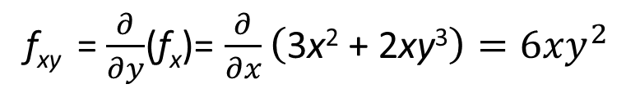
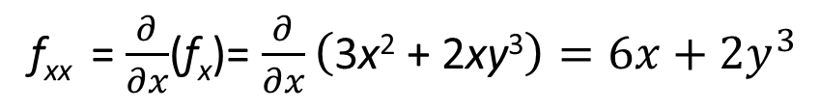
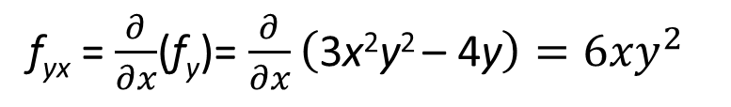
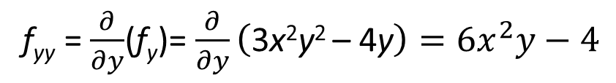
Example- (Cont’d)
Second order partial derivatives are given by
f_{xx} =$\frac{∂}{∂x}$(f_{x})= $\frac{∂}{∂x}\left(\text{3}\text{x}\text{2}\text{ + 2}\text{xy}\text{3}\right)=6x+2y^{3}$
f_{xy} =$\frac{∂}{∂y}$(f_{x})= $\frac{∂}{∂x}\left(\text{3}\text{x}\text{2}\text{ + 2}\text{xy}\text{3}\right)=6xy^{2}$
f_{yy} =$\frac{∂}{∂y}$(f_{y})= $\frac{∂}{∂y}\left(\text{3}\text{x}\text{2}\text{y}\text{2 }\text{– 4}\text{y}\right)=6x^{2}y−4$
f_{yx} =$\frac{∂}{∂x}$(f_{y})= $\frac{∂}{∂x}\left(\text{3}\text{x}\text{2}\text{y}\text{2 }\text{– 4}\text{y}\right)=6{xy}^{2}$

Slide 14
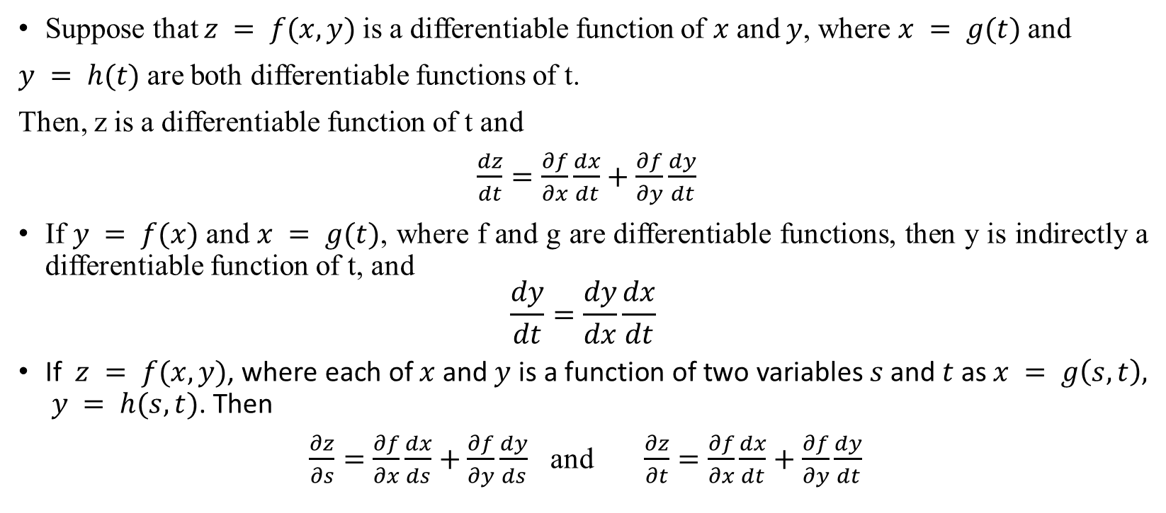
Chain Rule
Suppose that $z = f(x, y)$is a differentiable function of $x$ and $y$, where $x = g(t)$and
$y = h(t)$are both differentiable functions of t.
Then, z is a differentiable function of t and
$\frac{dz}{dt}=\frac{∂f}{∂x}\frac{dx}{dt}+\frac{∂f}{∂y}\frac{dy}{dt}$
If $y = f(x)$and $x = g(t)$, where f and g are differentiable functions, then y is indirectly a differentiable function of t, and
$$\frac{dy}{dt}=\frac{dy}{dx}\frac{dx}{dt}$$
If $z = f(x, y)$, where each of $x$ and $y$ is a function of two variables $s$and $t$as $x = g\left(s, t\right), y = h(s, t)$. Then
$\frac{∂z}{∂s}=\frac{∂f}{∂x}\frac{dx}{ds}+\frac{∂f}{∂y}\frac{dy}{ds}$ and $\frac{∂z}{∂t}=\frac{∂f}{∂x}\frac{dx}{dt}+\frac{∂f}{∂y}\frac{dy}{dt}$

Slide 15
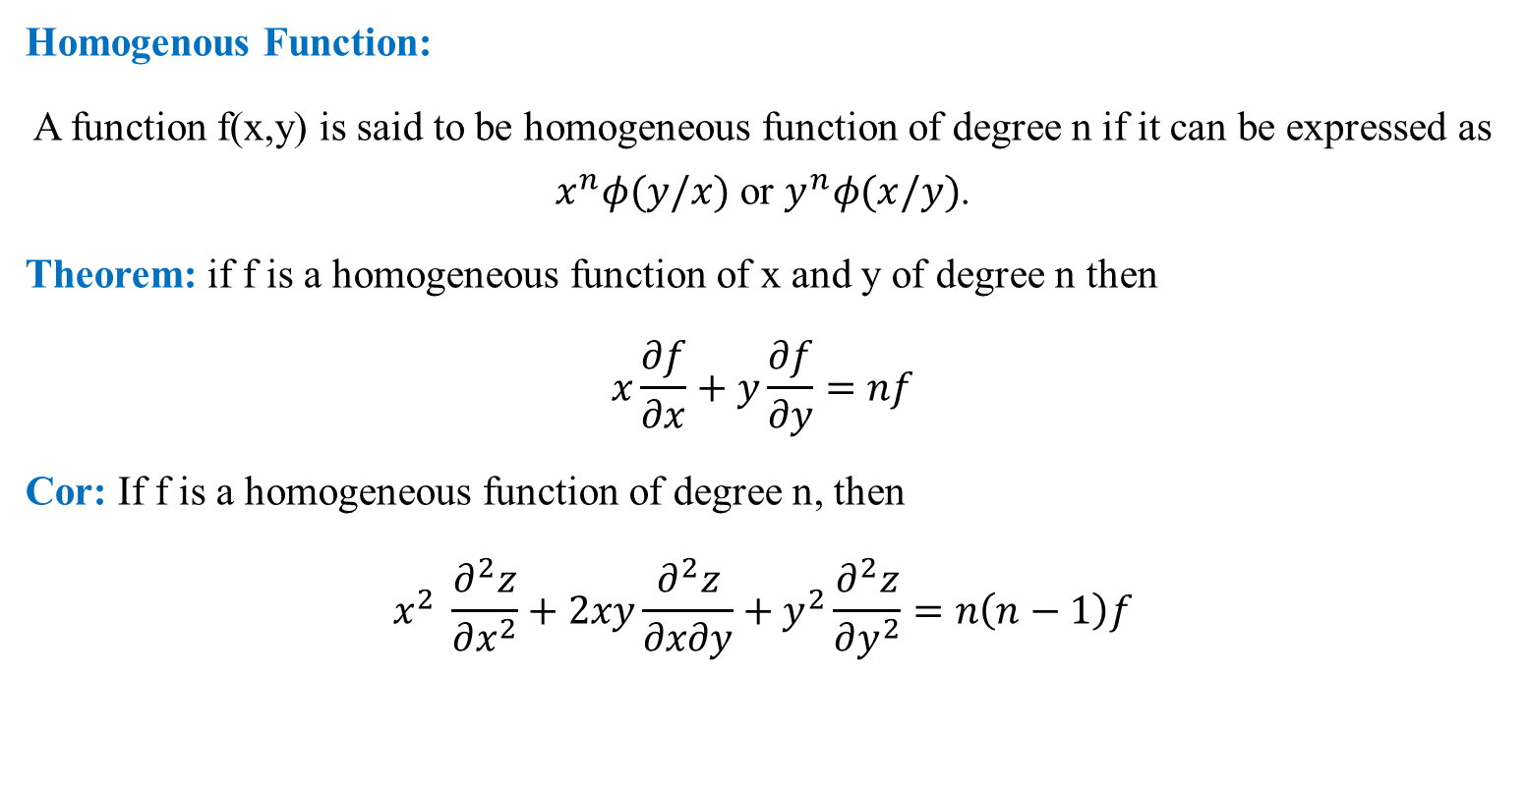
Euler’s Theorem
Homogenous Function:
A function f(x,y) is said to be homogeneous function of degree n if it can be expressed as $x^{n}φ(y/x)$ or $y^{n}φ(x/y)$.
Theorem: if f is a homogeneous function of x and y of degree n then
$$x\frac{∂f}{∂x}+y\frac{∂f}{∂y}=nf$$
Cor: If f is a homogeneous function of degree n, then
$$x^{2} \frac{∂^{2}z}{∂x^{2}}+2xy\frac{∂^{2}z}{∂x∂y}+y^{2}\frac{∂^{2}z}{∂y^{2}}=n\left(n−1\right)f$$

Slide 16
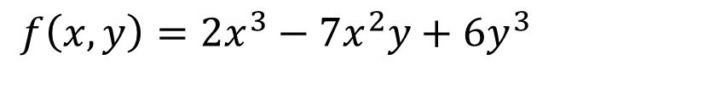
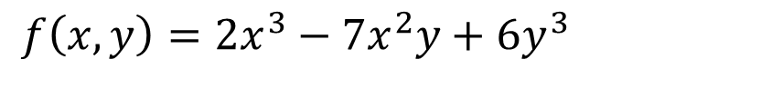

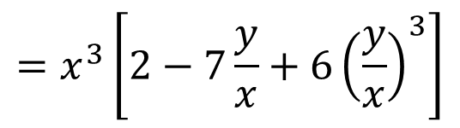
Example
Check whether the function f is homogeneous or not where
$${f\left(x,y\right)=2x}^{3}−7x^{2}y+6y^{3}$$
Sol:
$${f\left(x,y\right)=2x}^{3}−7x^{2}y+6y^{3}$$
$$=x^{3}\left[2−7\frac{y}{x}+6{\left(\frac{y}{x}\right)}^{3}\right]$$
$$=x^{3}∅\left[\frac{y}{x}\right]$$
It is a homogeneous function of degree 3 in x and y.

Slide 17
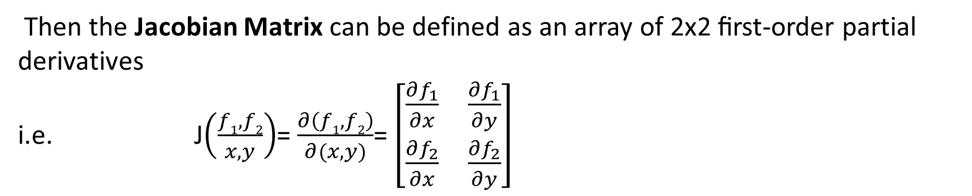
Jacobian
Suppose we have the system of 2 equations
f₁= z₁ (x ,y )
f₂ = z₂ (x ,y )
Then the Jacobian Matrix can be defined as an array of 2x2 ﬁrst-order partial derivatives
i.e. J$\left(\frac{f1,f2}{x,y}\right)$= $\frac{∂\left(f1,f2\right)}{∂(x,y)}$= $\left[\begin{matrix}\frac{∂f_{1}}{∂x} & \frac{∂f_{1}}{∂y} \\ \frac{∂f_{2}}{∂x} & \frac{∂f_{2}}{∂y}\end{matrix}\right]$

Slide 18
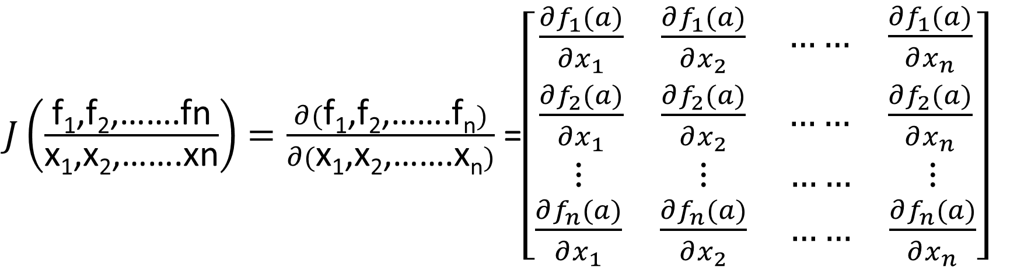
Jacobian(cont’d)
$J\left(\frac{\text{f}\text{1}\text{,}\text{f}\text{2}\text{,…….}\text{fn}}{\text{x}\text{1}\text{,}\text{x}\text{2}\text{,…….}\text{xn}}\right)=\frac{∂(\text{f}\text{1}\text{,}\text{f}\text{2}\text{,…….}\text{fn})}{∂(\text{x}\text{1}\text{,}\text{x}\text{2}\text{,…….}\text{xn})}$ =$\left[\begin{matrix}\begin{matrix}\frac{∂f_{1}(a)}{∂x_{1}} & \frac{∂f_{1}(a)}{∂x_{2}} \\ \frac{∂f_{2}(a)}{∂x_{1}} & \frac{∂f_{2}(a)}{∂x_{2}}\end{matrix} \begin{matrix}…… & \frac{∂f_{1}(a)}{∂x_{n}} \\ …… & \frac{∂f_{2}(a)}{∂x_{n}}\end{matrix} \\ \begin{matrix}⋮ & ⋮ \\ \frac{∂f_{n}(a)}{∂x_{1}} & \frac{∂f_{n}(a)}{∂x_{2}}\end{matrix} \begin{matrix}…… & ⋮ \\ …… & \frac{∂f_{n}(a)}{∂x_{n}}\end{matrix}\end{matrix}\right]$

Slide 19
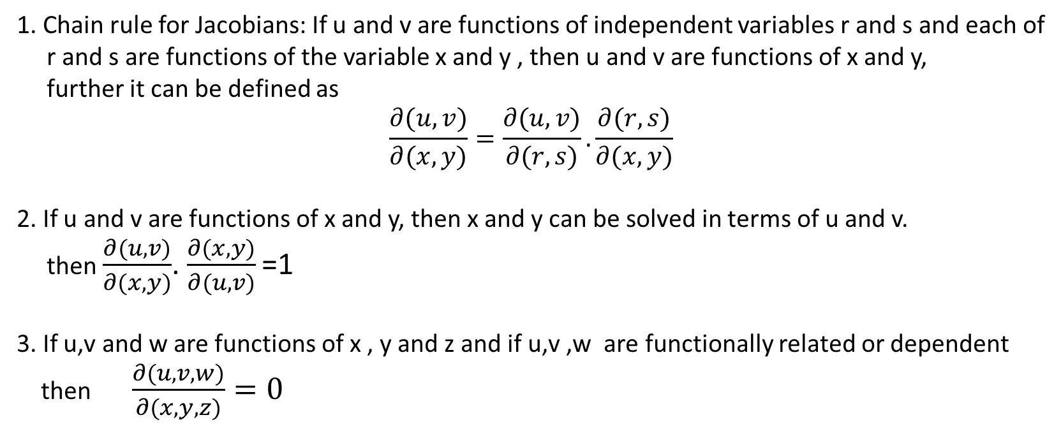
Properties of Jacobian
1. Chain rule for Jacobians: If u and v are functions of independent variables r and s and each of
r and s are functions of the variable x and y , then u and v are functions of x and y,
further it can be defined as
$$\frac{∂(u,v)}{∂(x,y)}=\frac{∂(u,v)}{∂(r,s)}.\frac{∂(r,s)}{∂(x,y)}$$
2. If u and v are functions of x and y, then x and y can be solved in terms of u and v.
then $\frac{∂(u,v)}{∂(x,y)}$. $\frac{∂(x,y)}{∂(u,v)}$ =1
3. If u,v and w are functions of x , y and z and if u,v ,w are functionally related or dependent
then $\frac{∂(u,v,w)}{∂(x,y,z)}=0$

Slide 20

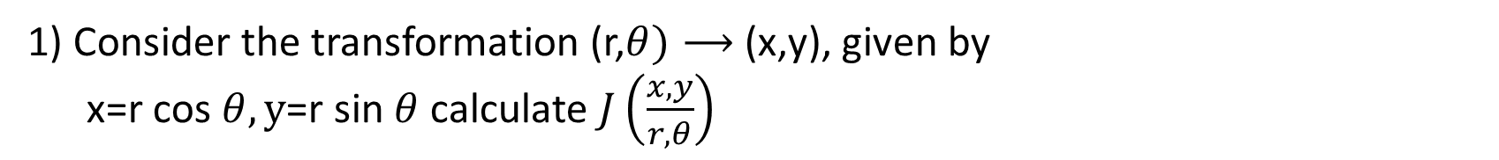
Example
1) Consider the transformation (r,$θ)⟶$ (x,y), given by
x=r cos $θ, y$=r sin $θ$ calculate $J\left(\frac{x,y}{r,θ}\right)$
Sol $J\left(\frac{x,y}{r,θ}\right)$= $\left|\begin{matrix}\frac{∂x}{∂r} & \frac{∂x}{∂θ} \\ \frac{∂y}{∂r} & \frac{∂y}{∂θ}\end{matrix}\right|$
= $\left|\begin{matrix}\cos{θ} & −r.sinθ \\ \sin{θ} & r\cos{θ} \end{matrix}\right|$=r $\cos{θ}$. $\cos{θ}$-(-r $\sin{θ}$ $\sin{θ}$)
= r

Slide 21
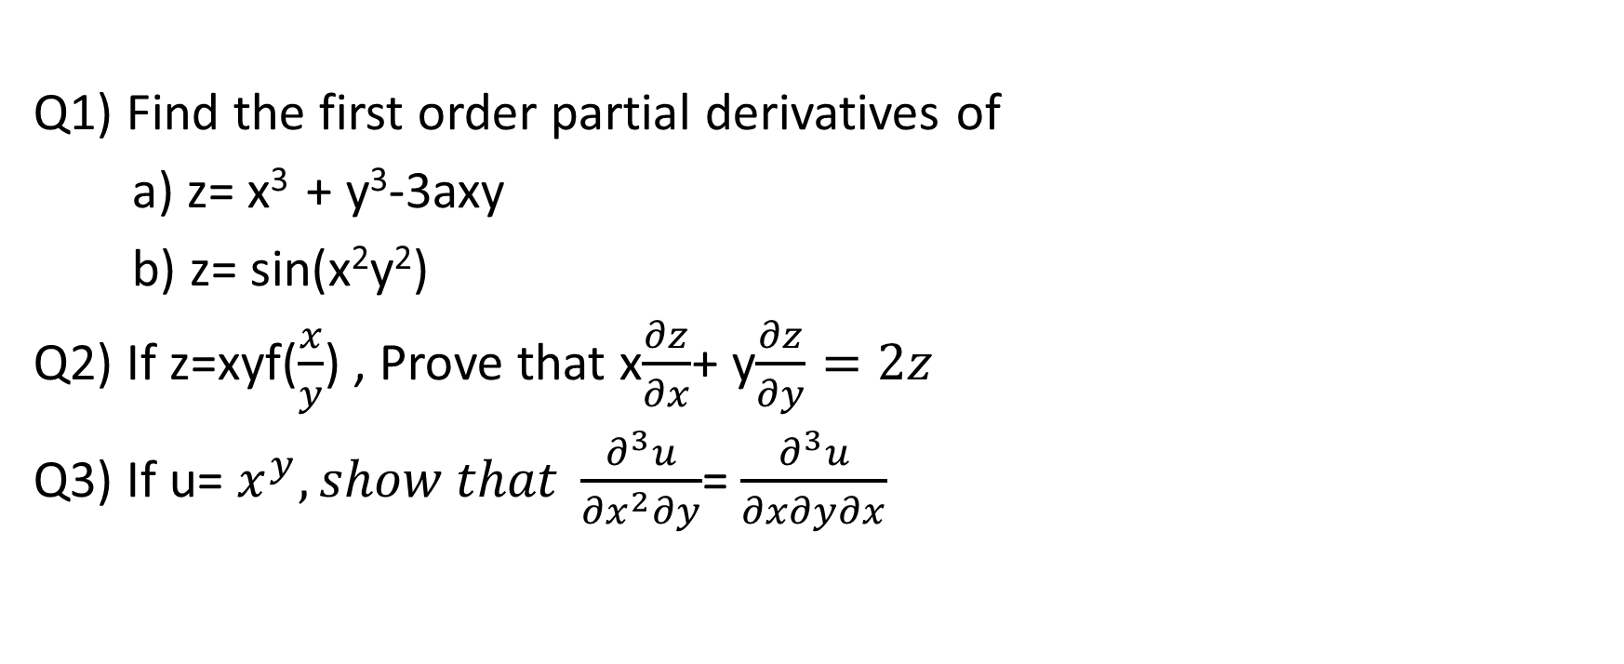
Practice Questions
Q1) Find the first order partial derivatives of
a) z= x³ + y³-3axy
b) z= sin(x²y²)
Q2) If z=xyf($\frac{x}{y}$) , Prove that x$\frac{∂z}{∂x}$+ y$\frac{∂z}{∂y}=2z$
Q3) If u= $x^{y}, show that \frac{∂^{3}u}{{∂x}^{2}∂y}$= $\frac{∂^{3}u}{∂x∂y∂x}$

Slide 22
Applications
The Jacobian determinant is used in the process of changing variables from cartesian to polar coordinates when evaluating double or higher integrals.
The Jacobian matrix is the best linear approximation to a diﬀerentiable function near a given point. So, we can think of the Jacobian as the derivative of a multivariate function.
Partial Derivatives are used in Partial Differential Equations e.g. Heat Eqn.

Slide 23

Text Books & Reference Books
Text Books:
1. E. Kreyszig , Advanced Engineering Mathematics, John Wiley,10th Ed.2011.,New Delhi.
2. H.K. Dass., Higher Engineering Mathematics, S Chand Publishers, 3rd revised edition, 2014.
3. B.S.Grewal, Higher Engineering Mathematics, Khanna Publishers, 42th ed.2013, New Delhi.
Reference Material:
1. R.K. Jain, and S.R.K. lyengar, Advanced Engineering Mathematics, 3rd Edition, Narosa Publishing House, 2004, New Delhi.
2. B.V. Ramana Advanced Engineering Mathematics, McGraw Hill, July 2006, New Delhi.
3. B. Thomas and , R.L., Finney ,Calculus and Analytic Geometry, Pearson Education, 11th Edition.
4. N.P. Bali and Manish Goyal, A text book of Engineering Mathematics, Laxmi Publications, Reprint, 2008.

Slide 24
THANK YOU

